Slide 1
Area- and Topology-Preserving
Polygon Simplification
CSD2183 Data Structures | DigiPen Institute of Technology
Based on Kronenfeld et al. (2020)
Notes:
Hello everyone. Today I will be presenting my implementation of Area- and Topology-Preserving Polygon Simplification for CSD2183 Data Structures. This project is based on the APSC algorithm from Kronenfeld and colleagues, published in 2020. The goal is to simplify polygon boundaries, reducing the number of vertices, while exactly preserving the area of each ring and maintaining valid topology throughout. Let me walk you through the problem, the algorithm, the data structures I used, and the experimental results.

Slide 2
The Problem
Cartographic polygons contain thousands of vertices,
far more than needed for display or storage.
Goal: reduce vertex count while satisfying:
Exact area preservation
No self-intersections or ring crossings
Minimize areal displacement
The APSC algorithm (Kronenfeld et al. 2020) achieves all
three constraints simultaneously through a greedy
collapse strategy.
3 Constraints
1
Area
Preserve ring areas exactly
2
Topology
No intersections or crossings
3
Quality
Minimize areal displacement
Notes:
So what is the problem? Cartographic polygons, like country borders or lake shorelines, often contain thousands of vertices. For efficient display and storage, we need to reduce that vertex count. But we cannot just throw vertices away randomly. We have three strict constraints. First, we must preserve the area of each ring exactly. Second, we must maintain valid topology: no self-intersections and no crossings between different rings. Third, we want to minimize the areal displacement, meaning the simplified shape should look as close to the original as possible. The APSC algorithm from Kronenfeld et al. achieves all three of these simultaneously using a greedy collapse approach, which I will explain next.

Slide 3
APSC Algorithm Overview
1
2
3
4
Identify 4-tuple
Compute E*
Place E
Collapse
For every consecutive
A → B → C → D in a ring
Area-preserving line
parallel to AD
Intersection of E* with
AB or CD (min displacement)
Remove B, C
Insert E between A and D
Area-Preserving Constraint
The line E* is defined by: a·xE + b·yE + c = 0
where a = yD - yA, b = xA - xD, c = f(A,B,C,D)
Any point E on this line exactly preserves the signed area of the ring. Among all such points, we choose the one that minimizes the symmetric difference area (areal displacement).
Notes:
Here is how the APSC algorithm works at a high level. For every four consecutive vertices A, B, C, D in a ring, we consider collapsing the middle two vertices B and C into a single replacement vertex E. The key insight is the area-preserving constraint. There exists a line E-star, parallel to the segment AD, such that any point E placed on this line will exactly preserve the ring's signed area. This is because the signed area contributed by the path A-B-C-D equals the area contributed by A-E-D when E lies on E-star. Among all points on E-star, we pick the one that minimizes areal displacement. Specifically, we compute the intersection of E-star with line AB and with line CD, and choose whichever gives less displacement. The collapse operation then removes B and C from the linked list and inserts E between A and D.

Slide 4
Greedy Collapse Strategy
1
2
3
4
5
Compute displacement cost
for all 4-tuples across
all rings
▶
Push all candidates into
a min-heap priority queue
(lowest cost first)
▶
Pop minimum candidate.
If stale (vertices removed),
discard and pop next
▶
Check topology: would
collapse cause any
intersection?
▶
If valid, perform collapse.
Re-enqueue ~4 new
candidates in neighborhood
Lazy Deletion: Instead of removing stale entries from the heap (expensive O(n) scan), we simply check validity when popping. If a candidate's vertices B or C have already been removed, or the adjacency A→B→C→D no longer holds, we discard it and move to the next. This keeps the heap operations at O(log n) per step.
Repeat steps 3-5 until total vertex count reaches the target
Notes:
The algorithm uses a greedy strategy. First, we compute the displacement cost for every possible 4-tuple collapse across all rings and push them all into a min-heap priority queue. Then we enter the main loop. We pop the candidate with the lowest displacement cost. But this candidate might be stale, meaning one of its vertices was already removed by a previous collapse. Rather than doing expensive decrease-key operations on the heap, we use lazy deletion: we just check if the candidate is still valid when we pop it. If the vertices B and C still exist and the adjacency A to B to C to D still holds, we proceed. Otherwise, we discard it and pop the next one. Before performing the collapse, we also check that it would not cause any topological violation, which I will discuss in a later slide. If everything checks out, we perform the collapse and enqueue approximately four new candidates covering the updated neighborhood around the new vertex E. We repeat until we reach the target vertex count.

Slide 5
Data Structure 1: Doubly-Linked Circular List
Each ring is a circular doubly-linked list of Vertex nodes.
O(1) removal and insertion during collapse
Circular structure: last vertex links back to first
One list per ring (exterior + each hole)
Tombstone Pattern
Removed vertices are marked removed=true but not freed immediately. This allows safe stale-candidate checks in the priority queue. Memory is reclaimed in a batch flush after simplification completes.
Ring Structure
A
...
B
D
C
prev / next pointers form a circle
Notes:
The first key data structure is the doubly-linked circular list. Each ring of the polygon, whether it is the exterior boundary or a hole, is stored as its own circular doubly-linked list of Vertex nodes. This gives us O(1) removal and insertion, which is critical because every collapse removes two vertices and inserts one. An important design decision is the tombstone pattern. When we remove a vertex during a collapse, we do not immediately free its memory. Instead, we set a removed flag to true. This is necessary because there may still be stale candidates in the priority queue that reference this vertex. When we pop those candidates later, we check the removed flag and discard them. The actual memory is freed in a batch flush after simplification completes.

Slide 6
Data Structure 2: Min-Heap Priority Queue
Candidate Struct
Deterministic Tie-Breaking
displacement
→ areal displacement cost (sort key)
Ex, Ey
→ position of replacement vertex E
ring_id, A, B, C, D
→ ring ID and vertex pointers
1. displacement (lowest first)
2. ring_id
3. vertex IDs (B, C, A, D)
4. pointer address (final fallback)
Ensures identical output across runs
std::priority_queue<Candidate, vector, greater>
Push: O(log n) | Pop: O(log n) | Lazy deletion: O(1) validity check on pop
Notes:
The second data structure is the min-heap priority queue. We use the standard library priority queue with a greater comparator to get a min-heap, so the candidate with the lowest areal displacement is always on top. Each candidate stores the displacement cost, the computed position of the replacement vertex E, the ring ID, and pointers to the four vertices A, B, C, and D. An important detail is deterministic tie-breaking. When two candidates have the same displacement cost within floating-point tolerance, we break ties by ring ID, then by vertex IDs, and finally by pointer address. This ensures that the output is identical across runs. As I mentioned earlier, we use lazy deletion rather than a decrease-key operation. When a collapse changes the neighborhood, we just push new candidates. The old ones remain in the heap and are discarded when popped if their vertices are no longer valid. This keeps each heap operation at O(log n).

Slide 7
Data Structure 3: Spatial Grid Index
Uniform grid over the polygon's bounding box
√n × √n cells
Each polygon edge registered in all overlapping cells
Intersection query checks only edges in relevant cells
Incremental insert/remove after each collapse
Complexity Comparison
Naive scan: O(n) per query
Spatial grid: O(√n) per query
Overall: O(n) collapses × O(√n) each = O(n√n)
Grid Partitioning
Query only
highlighted cells
Notes:
The third and most impactful data structure is the spatial grid index. This is what takes us from a naive O(n) per-query intersection check to O(square root of n). The idea is simple: we divide the polygon's bounding box into a grid of square root n by square root n cells. Each polygon edge is registered in every cell it overlaps. When we need to check if a proposed collapse causes an intersection, instead of scanning every edge in the polygon, we only check edges in the cells that the new segments A-E and E-D pass through. On average, this means we only check O(square root n) edges per query instead of O(n). The grid is maintained incrementally. After each collapse, we remove the old edges from their cells and insert the new edges. This gives us an overall time complexity of O(n times square root n) for the entire simplification, since we perform O(n) collapses each costing O(square root n). This is crucial for scaling to large polygons with tens of thousands of vertices.

Slide 8
Topology Preservation
Same-Ring Check
Cross-Ring Check
New edges A→E and E→D must not
intersect any other edge in the same ring
New edges must not cross edges
of any other ring (exterior or hole)
Prevents self-intersection
Prevents ring boundary violations
Implementation Details
Robust orientation predicates using long double precision arithmetic
Collinear overlap detection for near-degenerate edge cases
Spatial grid accelerates both same-ring and cross-ring queries
If any intersection detected → skip candidate, pop next from heap
Notes:
Topology preservation is critical. Before every collapse, we perform two types of checks. The same-ring check verifies that the new edges A-to-E and E-to-D do not intersect any other edge in the same ring. This prevents self-intersection. The cross-ring check verifies that the new edges do not cross edges of any other ring, which prevents boundary violations between the exterior and holes. The implementation uses robust orientation predicates computed with long double precision to handle near-degenerate cases where vertices are almost collinear. We also have special handling for collinear overlap, where two segments lie on the same line and partially overlap. Both types of intersection queries are accelerated by the spatial grid. If any intersection is detected, we simply skip that candidate and move on to the next one in the heap. The algorithm never produces an invalid topology.

Slide 9
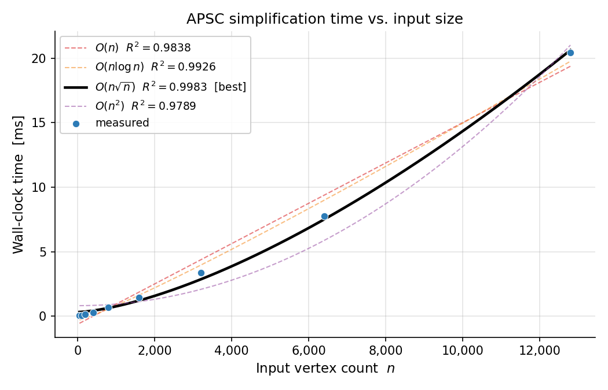
Results: Time Complexity
Key Findings
O(n√n)
R² = 0.9989
n = 50: 0.044 ms
n = 12,800: 21.4 ms
Matches theory:
O(n) collapses × O(√n)
spatial query each
O(n log n) fits well too
(R² = 0.991) but √n
dominates at this scale
Notes:
Now let's look at the experimental results. This plot shows wall-clock time versus input size for synthetic polygons ranging from 50 to 12,800 vertices, all simplified to 50 percent of their original count. The best-fitting model is O(n times square root n) with an R-squared of 0.9989, which is an excellent fit. This matches our theoretical analysis exactly: we perform O(n) collapse steps, and each step requires an O(square root n) spatial grid intersection query. The O(n log n) model also fits well with R-squared 0.991, which makes sense because the heap operations contribute an n log n term, but at this scale the square root n factor from the spatial queries dominates. In absolute terms, simplifying 12,800 vertices takes only 21 milliseconds, which is very practical.

Slide 10
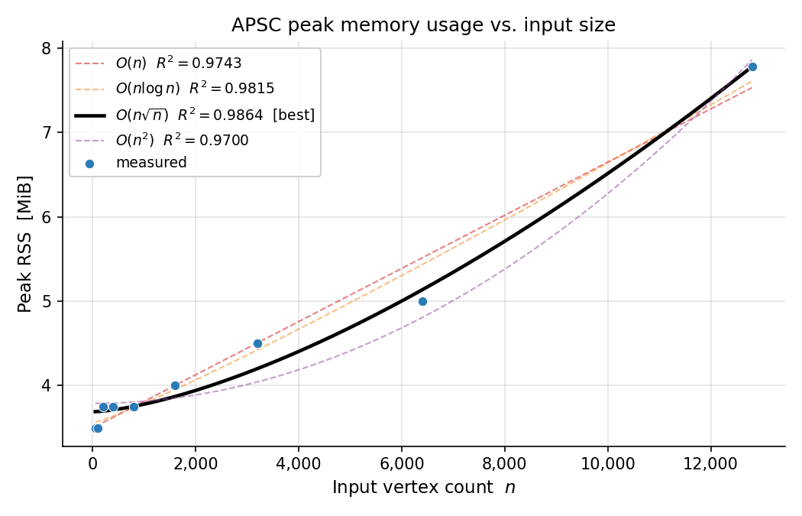
Results: Memory Usage
Key Findings
7.8 MiB
peak at n = 12,800
Near-linear growth
3.5 MiB baseline (runtime overhead)
Only 2.2× increase for 256× more vertices
Theoretical: O(n)
Practical on any modern machine
Notes:
For memory usage, the peak resident set size grows from about 3.5 megabytes at 50 vertices to 7.8 megabytes at 12,800 vertices. That is only a 2.2 times increase for a 256 times increase in input size, which is very close to the theoretical O(n) bound. The 3.5 megabyte baseline is the fixed cost of the C++ runtime and the executable image itself. The actual data structures, the linked lists, the priority queue, and the spatial grid, contribute relatively modest memory overhead. At the largest tested input, 12,800 vertices, the program uses under 8 megabytes, meaning this implementation is practical on essentially any modern machine.

Slide 11
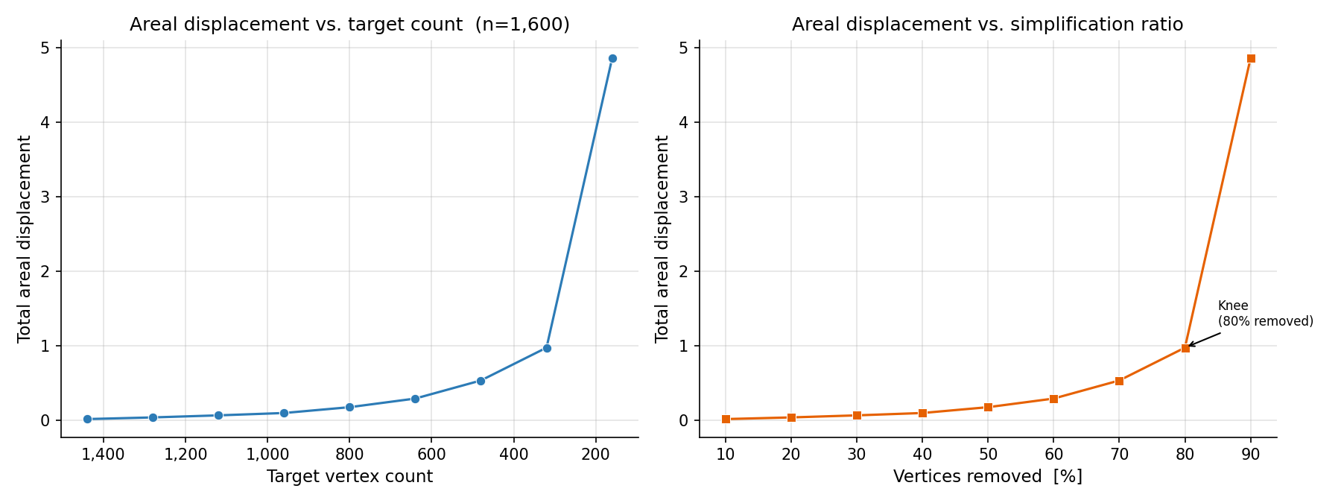
Results: Areal Displacement vs. Target
Observations
Near-lossless regime
Removing <30% of vertices:
displacement stays very low
Knee of the curve
Around 40% of original count,
cost per step rises sharply
Aggressive removal
90% removal: 271× more
displacement than 10% removal
Area preserved exactly
in all tested cases
Notes:
This plot shows how areal displacement increases as we remove more vertices from a fixed polygon with 1,600 vertices. There are three distinct regimes. First, the near-lossless regime: when removing less than 30 percent of vertices, the displacement stays very low because the greedy algorithm correctly collapses the cheapest candidates first. Second, there is a knee in the curve around 40 percent of the original count, where the cost per collapse step rises sharply as cheap candidates are exhausted. Third, in the aggressive regime, removing 90 percent of vertices results in 271 times more displacement than removing only 10 percent. Importantly, the signed area is preserved exactly in every single test case, confirming that the area-preserving constraint works correctly.

Slide 12
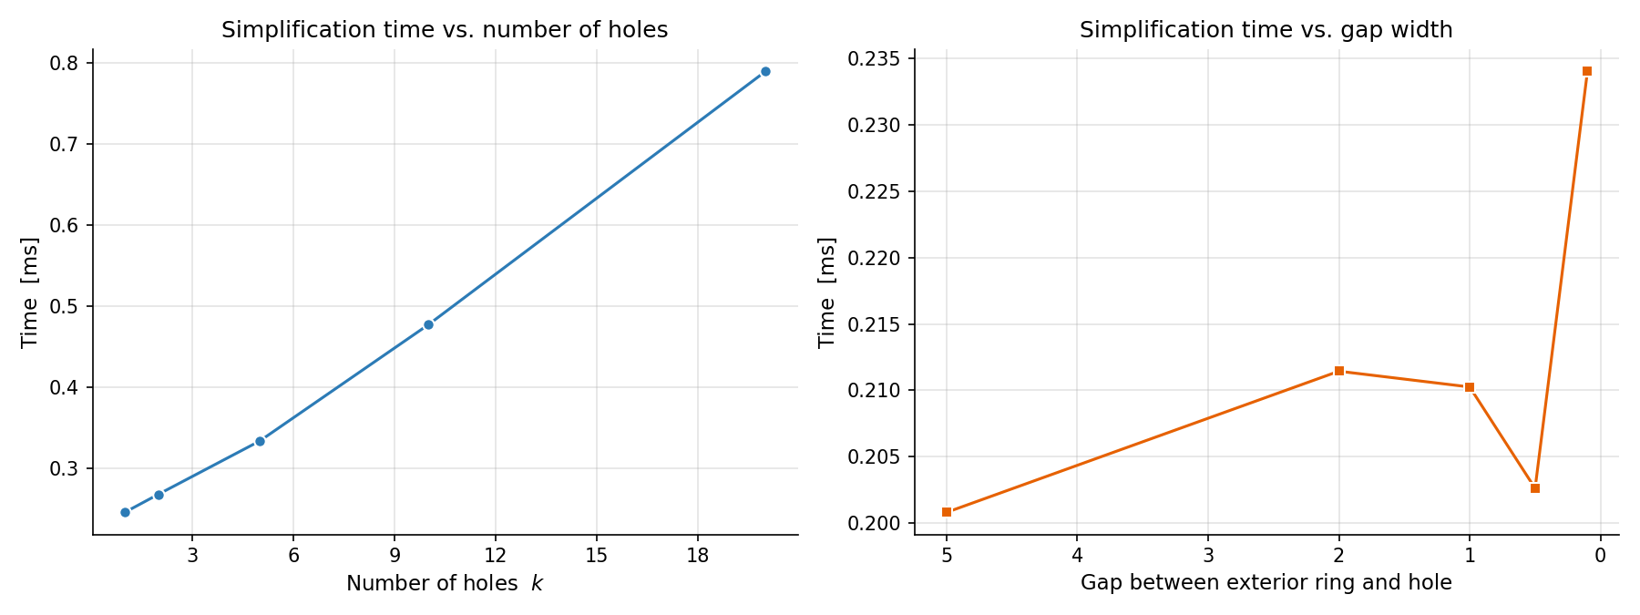
Stress Tests
Many Holes (up to 20)
Sub-linear time growth with hole count.
20 holes: only 3.4× slower than 1 hole.
Narrow Gaps (down to 0.1 units)
Constant runtime regardless of gap width.
Grid cell size is bounding-box based.
Near-Degenerate Shapes
Comb, zigzag, 50:1 ellipse: all valid.
Area error < 1×10⁻⁹ in every case.
Notes:
We also ran several stress tests to validate robustness. First, polygons with many holes, up to 20 interior rings. The runtime grows sub-linearly with the number of holes. A 20-hole polygon is only 3.4 times slower than a single-hole polygon, even though it has 2.4 times more vertices. The spatial grid keeps cross-ring queries efficient. Second, narrow-gap polygons where the exterior and hole are separated by as little as 0.1 world units. The runtime is essentially constant regardless of gap width, confirming that the spatial grid's performance does not degrade with geometric proximity. Third, near-degenerate shapes including comb patterns, zigzag bands, and elongated ellipses with a 50-to-1 aspect ratio. All produced valid simplified polygons with area error below one times ten to the negative ninth.

Slide 13
Summary & Conclusion
O(n√n) Time
Exact Area
Min-heap + spatial grid
Preserved by construction
Valid Topology
15/15 Tests Pass
Robust intersection checks
All reference cases correct
12,800 vertices simplified in 21 ms using 7.8 MiB of memory
Notes:
To summarize: I implemented the APSC algorithm with three key data structures. A doubly-linked circular list for O(1) vertex manipulation, a min-heap priority queue with lazy deletion for greedy candidate selection, and a uniform spatial grid index for O(square root n) intersection queries. Together, these achieve O(n square root n) overall time complexity. The algorithm exactly preserves ring areas by construction, and topology is maintained through robust intersection checks using long double precision. All 15 reference test cases pass correctly. In practical terms, simplifying a polygon with 12,800 vertices takes only 21 milliseconds and 7.8 megabytes of memory. The implementation handles stress cases well, including polygons with many holes, narrow gaps, and near-degenerate geometries. Thank you for watching. I am happy to take any questions.

